Slide 1

Travelling Salesman Problem
OPTIMIZATION METHODS - I
-Dikshant Joshi

Slide 2

Agenda
Overview
Application of TSP
Problem Statement
Formulation of LP
Subtour Elimination
Modelling using AMPL
Results

Slide 3

OVERVIEW
A
B
The Travelling Salesman Problem (TSP) is a classic optimization problem.
It involves finding the shortest possible route that a salesman can take to visit a set of cities exactly once and return to the starting city.
C
D

Slide 4

APPLICATION OF TSP
Planning Delivery Routes
Optimizing Manufacturing Processes
Job Processing
School Bus Routing
Theorem: (Karp, 1972) TSP is NP-Complete. (That is, every other hard problem is reducible to TSP.)

Slide 5

PROBLEM STATEMENT
A
B
C
There are 5 cities A,B,C,D,E and a logistics company must deliver one product in each city.
There are distances involved with edges between each of the cities.
Based on the distance logistics company must find shortest path that would cover all the cities and return to the starting city.
D
E
 | A | B | C | D | E
A | 0 | 120 | 220 | 150 | 210
B | 120 | 0 | 80 | 110 | 130
C | 220 | 90 | 0 | 160 | 185
D | 150 | 110 | 160 | 0 | 190
E | 210 | 130 | 185 | 190 | 0

Slide 6
PROBLEM STATEMENT
A
B
C
There are 5 cities A,B,C,D,E and a logistics company must deliver one product in each city.
There are distances involved with edges between each of the cities.
Based on the distance logistics company must find shortest path that would cover all the cities and return to the starting city.
D
E
 | A | B | C | D | E
A | 0 | 120 | 220 | 150 | 210
B | 120 | 0 | 80 | 110 | 130
C | 220 | 90 | 0 | 160 | 185
D | 150 | 110 | 160 | 0 | 190
E | 210 | 130 | 185 | 190 | 0

Slide 7


FORMULATION OF LP
Decision Variables
X_{ij} : a binary variable that indicates whether the salesman travels directly from city i to city j (1 if yes, 0 if not).
Objective Function:
Minimize Z: $\sum_{i,j}{C_{ij}×X_{ij}}$ 𝑖𝑗 ∈ 𝐸,
Where E is the set of all edges and C is distance between city i & j .
 | A | B | C | D | E
A | 0 | 120 | 220 | 150 | 210
B | 120 | 0 | 80 | 110 | 130
C | 220 | 90 | 0 | 160 | 185
D | 150 | 110 | 160 | 0 | 190
E | 210 | 130 | 185 | 190 | 0

Slide 8

FORMULATION OF LP
A
A
Constraints
Salesman must visit each city exactly once:
$\sum_{i}{X_{ij}}$ = 1 for all j
Salesman must leave each city exactly once:
$\sum_{i}{X_{ji}}$ = 1 for all j
The optimum route should contain at-most n edges:
$\sum_{i,j}{X_{ij}}$ <= n
A
B
C
D
E

Slide 9

FORMULATION OF LP
A
Constraints
Subtour Elimination:
Method 1
$\sum_{i∈S,j∈S,i≠j}{X_{ij}}$ <= |S|-1 ∀ S ⊂ V , |S| >= 2
Method 2 (MTZ – Miller Tucker Zemlin)
$Ui – Uj + N∗Xij<=N−1 ∀ i,j : i≠1 , j≠1$, 2<=U_{i}<=N given U₁=1
where N is the number of Nodes and U_{i} variable is the sequence of visit of node i.
B
C
D
E

Slide 10



Subtour Elimination
A
$Ui – Uj + N∗Xij<=N−1 ∀ i,j : i≠1 , j≠1$
$$UC – UD +5∗XCD≤4$$
$$UC – UD +5∗1≤4$$
$$UC – UD +1≤0$$
$$UC+1≤UD=2$$
$$UC=1$$
B
C
D
E

Slide 11

Subtour Elimination
A
$Ui – Uj + N∗Xij<=N−1 ∀ i,j : i≠1 , j≠1$
$$UC – UD +5∗XCD≤4$$
$$UC – UD +5∗1≤4$$
$$UC – UD +1≤0$$
$$UC+1≤UD=2$$
$$UC=1$$
B
C
$$UD=2$$
D
E

Slide 12

Subtour Elimination
A
$Ui – Uj + N∗Xij<=N−1 ∀ i,j : i≠1 , j≠1$
$$UC – UD +5∗XCD≤4$$
$$UC – UD +5∗1≤4$$
$$UC – UD +1≤0$$
$$UC+1≤UD=2$$
$UD – UE +5∗XDE≤4$
$UD – UE +5∗1≤4$
$UD – UE +1≤0$
$UD+1≤UE=3$
$$UC=1$$
B
C
$$UD=2$$
D
E

Slide 13


Subtour Elimination
A
$Ui – Uj + N∗Xij<=N−1 ∀ i,j : i≠1 , j≠1$
$$UC – UD +5∗XCD≤4$$
$$UC – UD +5∗1≤4$$
$$UC – UD +1≤0$$
$$UC+1≤UD=2$$
$UD – UE +5∗XDE≤4$
$UD – UE +5∗1≤4$
$UD – UE +1≤0$
$UD+1≤UE=3$
$$UC=1$$
B
C
$$UD=2$$
D
E
$$UE=3$$

Slide 14

Subtour Elimination
A
$Ui – Uj + N∗Xij<=N−1 ∀ i,j : i≠1 , j≠1$
$$UC – UD +5∗XCD≤4$$
$$UC – UD +5∗1≤4$$
$$UC – UD +1≤0$$
$$UC+1≤UD=2$$
$UD – UE +5∗XDE≤4$ $UE – UC +5∗XEC≤4$
$UD – UE +5∗1≤4$ $UE – UC +5∗1≤4$
$UD – UE +1≤0$ $UE – UC +1≤0$
$UD+1≤UE=3$ $UE+1≤UC =4$
Which contradicts with U_{C}=1
$$UC=1$$
B
C
$$UD=2$$
D
E
$$UE=3$$

Slide 15
Subtour Elimination
A
$Ui – Uj + N∗Xij<=N−1 ∀ i,j : i≠1 , j≠1$
$$UC – UD +5∗XCD≤4$$
$$UC – UD +5∗1≤4$$
$$UC – UD +1≤0$$
$$UC+1≤UD=2$$
$UD – UE +5∗XDE≤4$ $UE – UC +5∗XEC≤4$
$UD – UE +5∗1≤4$ $UE – UC +5∗1≤4$
$UD – UE +1≤0$ $UE – UC +1≤0$
$UD+1≤UE=3$ $UE+1≤UC =4$
Which contradicts with U_{C}=1
$$UC=1$$
B
C
$$UD=2$$
D
E
$$UE=3$$

Slide 16

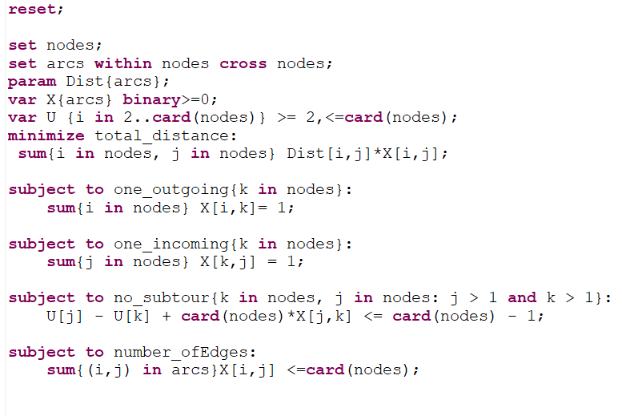
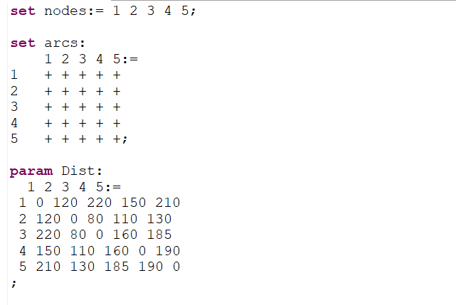
MODELLING USING AMPL
Model File
Data File

Slide 17

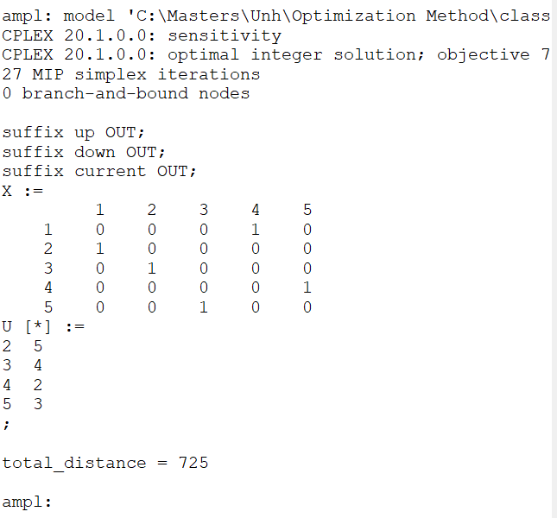
RESULT
The Optimum Route for the problem is :
1 (A) → 4 (D) → 5 (E) → 3 (C) → 2 (B) → 1 (A)
The minimized distance : 725

Slide 18

Thank you
QUESTIONS ?

